Slide 1


Rhode Island Executive Office of Health & Human Services (RI EOHHS) / Sandata
Open Electronic Visit Verification (EVV) Model for Home Health Care Services (HHCS)

Slide 2
What is EVV?
Section 12006 of the 21St Century Cures Act (the Cures Act), P.L. 114-255, added Section 1903(l) of the Social Security Act (SSA). Section 1903(l) provides that states must require the use of an electronic visit verification (EVV) system for personal care services (PCS) and home health care services (HHCS) that require an in-home visit by a provider.
EVV must capture six required data elements electronically:
  1) the type of service performed;
  2) the individual receiving the service;
  3) the date of the service;
  4) the location of service delivery;
  5) the individual providing the service; and
  6) the time the service begins and ends

Slide 3

Phase II Home Health Care Services
The RI Medicaid program has begun preparing for the second phase of the Electronic Visit Verification implementation to include Home Health Care Services provided in the member’s home.
This will bring the state into full compliance with Congress’ 21st Century Cures Act, Section 12006(a), effective January 1, 2023.
Rhode Island Medicaid will have a soft launch period, beginning in mid-August 2022, to familiarize providers with the use of EVV before incorporating claims editing. This soft launch period will continue through the end of the year 2022.

Slide 4
Home Health Care Services Expansion

Slide 5
Phase II Home Health Care Services
EVV is required on Home Health Care Services provided in the home effective 1/1/2023.
The expanded services codes included are (please note, these codes with additional modifiers will be included in the addendum once completed. This is not intended to be used as the list to program systems by. This is informational only):

Slide 6
Sandata Agency Management EVV system System Overview
Sandata Overview
OPEN EVV MODEL:
The Open EVV model allows providers to leverage their existing EVV systems OR the Sandata Agency Management EVV system system provided by RI EOHHS for Home Health Care Services. All existing third-party systems will need to be re-certified for inclusion of new service codes.
Sandata Agency Management EVV system:
Caregiver:
  Sandata Mobile Connect
  Telephonic Visit Verification
  Fixed Visit Verification
Provider: Sandata Agency Management EVV system Portal
Third-Party EVV*:
Caregiver: Existing EVV System
Provider: Existing EVV System
Third-Party Vendor: sends EVV data to the Sandata Aggregator
  *Assumes Third-Party EVV system meets RI EOHHS program rules

Slide 7
Sandata Agency Management EVV System

Slide 8
Sandata Agency Management EVV system –
Example Visit
The caregiver:
Arrives at the place of service.
Checks in using one of the following technologies:
  Sandata Mobile Connect
  Telephonic Visit Verification
  Fixed Visit Verification
Provides service(s).
Follows the same procedures to clock out (except for fixed visit verification that requires only one call to capture both the check in and check out values).

Slide 9
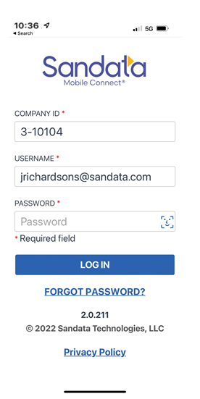
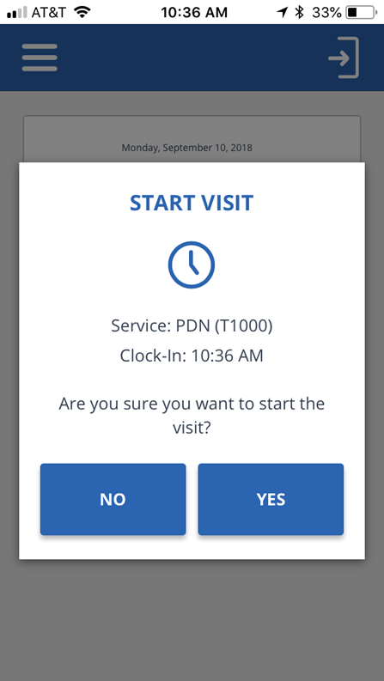
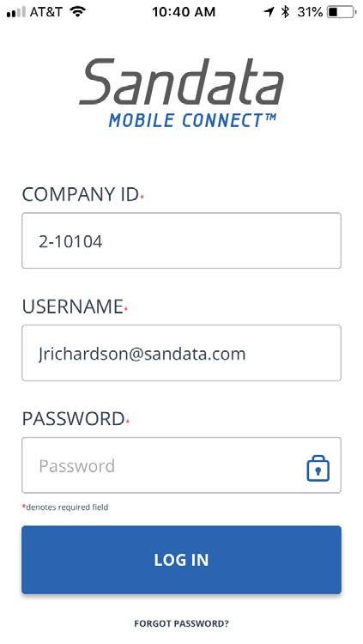
Sandata Agency Management EVV system –
Sandata Mobile Connect
Primary EVV method
Application can be loaded on Android or iOS
Works in both connected and disconnected mode
Start time and end time is verified with GPS to the member address(es)
GPS location captured at check in and out only
Bring you own device and data/WIFI
ADA 508 and HIPAA compliant

Slide 10
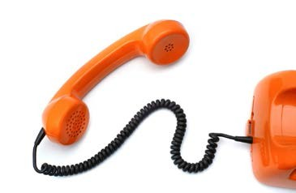
Sandata Agency Management EVV system –
Sandata Telephonic Visit Verification
Secondary EVV method
Upon arriving call the toll-free phone number
“Welcome, please enter your ID”
Enter your EVV ID
“Press 1 to clock in or press 2 to clock out”
Press 1
“Received at <time>”
Hang up.
Repeat same process for end time of service, with the additional step of entering optional tasks associated with the visit.

Slide 11
Sandata Agency Management EVV system –
Provider EVV Portal
Each Provider Agency receives their own EVV portal accessible via the web
Real-time monitoring of visit data
Exceptions for visits that are missing required data
Ability to correct visit exceptions when allowed, using reason codes (includes full audit trail)
Summary and detail reporting
Payer data integration
HIPAA-compliant data management

Slide 12
Third-Party EVV

Slide 13
Third-Party EVV
  Third-Party EVV, or ‘Alternate’ EVV data is a feature available to payer programs using the Sandata Aggregator system.
  This allows the RI EOHHS EVV program to accept EVV visit information from providers using their own EVV systems outside of the one supplied by the state.
  Sandata and State refer to this as an ‘Open’ program.
  Data from third-party EVV systems is delivered to RI EOHHS’s Aggregator via a standard EVV interface specification supplied by Sandata.
  All visit data supplied for the RI EOHHS’ EVV program is evaluated against the same set of program rules- for 21st Century Cures compliance as well as state requirements.

Slide 14

Third-Party EVV Data Interfaces
Data from Vendor Systems:
Member Data
  Payer/Program/Service association
Caregiver Data
EVV Visit Data
  Changes to visits
  Address program standard exceptions / reason codes
It is very important that your third-party vendor follow the Rhode Island specific third-party technical specifications in order to ensure all of your visits pass through to the aggregator.
Key Questions to Address:
To be addressed in Business Rules
RI EOHHS EVV Program Guidance:
State distributed Provider survey will indicate Third-Party EVV providers and will guide vendor engagement.
Data Type | Third-Party EVV (Visit, Member, Caregiver)
EVV Required? | Yes
Source | EVV Vendors
Interface Methods:
Web Registration Portal | No
Web API (JSON) | Yes
Delimited Files | Yes
EVV App Entry (Manual) | No
EVV App Upload | No
EVV Program Uses | Vendor-sourced EVV data, with exceptions and visit change data, is key to an open EVV program. This data is evaluated against the payer’s formatting & program rules, then loaded in the Aggregator.

Slide 15
Third-Party EVV Data Testing Process
Provider Outreach / Registration
Interface Testing
Credential Delivery
Vendor Specification
Provider Support
Production Ready
Vendor Support
Provider survey opens
Alt EVV specifications published
Engage with providers’ vendors
Vendor test credentials issued
Vendor test data uploaded
EVV data format validation automated process
Review of testing results to complete testing
Dedicated Sandata team for EVV vendor support
EVV program customer care Help Desk support to assist providers with questions
Production credentials sent to Vendors to transmit data
Provider receives notification and access to their Aggregator portal
Ongoing data delivery and support

Slide 16


Third-Party EVV: Integration Vendor-Centric Model
Provider Agency Focus: Delivery of Care
Goal is to minimize the impact to the provider agencies by engaging directly with the EVV system vendors at a technical level.
Providers keep using their existing systems, and don’t focus on system interfaces for their EVV.
When their vendor completes Alt EVV testing and turns on their interface, the provider can verify their data is flowing to the RI EOHHS Aggregator correctly.
EVV Vendor Focus: System Integration
Leverage Sandata’s standard Data Specifications, used in 20 other EVV programs throughout the country.
Many vendors already have experience and interfaces with the Sandata Aggregator in other states.
Focus on testing the RI EOHHS specific program rules

Slide 17
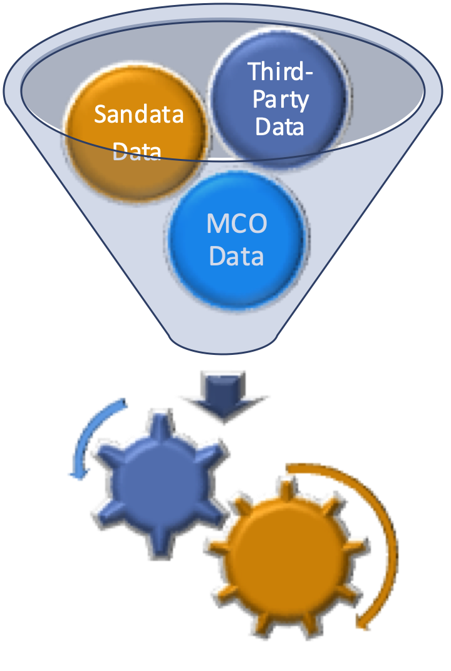
Open EVV Data Model
Providers using RI EOHHS-supplied Sandata Agency Management EVV system™
RI EOHHS Home Health
Program Aggregator
Provider
Agency
EVV Activity Captured
(Sandata Agency Management EVV system™ with RI EOHHS-specific Rules)
Data Exports
The Aggregator / Third-Party EVV model allows providers to use the EVV system of their choice and still deliver EVV data that is consistent with the state’s EVV program and policies.
Aggregator
Reporting
Complete EVV Program Information
Claim / Encounter Verification (Future)
Providers using Third-Party EVV Systems:
Provider
Agency
EVV Activity
(via Third-Party EVV System / Vendor)
EVV Data
RI EOHHS EVV
Program Rules Check
Vendor Created Process
Program Rule Exceptions

Slide 18
Provider EVV Costs
Sandata Agency Management EVV system System:
Sandata Agency Management EVV system is available free of charge
Sandata Mobile Connect: Bring your own device and data plan
Third-Party EVV Systems:
Providers using third-party EVV systems will continue to pay for them as they do today
Providers using third-party EVV systems could incur fees from your EVV vendor for the Aggregator data interface work

Slide 19
What’s next?
RI EOHHS EVV Website will house all EVV updates and documents
  Electronic Visit Verification (EVV) | Executive Office of Health and Human Services
RI EOHHS to provide EVV frequently asked questions (FAQ)-These will be sent out via email and placed on the State webpage above.
Third-Party EVV town halls
For questions about EVV in Rhode Island, please email OHHS.EVVEscalation@ohhs.ri.gov

Slide 20
What’s next?
Sandata Agency Management EVV system System Training:
  Additional Training Information and Details will be provided
  Online Training Registration
  Training will be provided via webinars and independent training via learning system and recorded videos
  Once Trained, Providers will receive Welcome Kit to access their Sandata Agency Management EVV system system

